Slide 1
The Effect of Dark
Chocolate and Methamphetamine on Memory
By: Henry Johnson, Mary McSweeney, Olivia Motmans, and Rishabh Sood

Slide 2
Research Questions
Do dark chocolate and/or methamphetamine have an impact on memory?
How significant are these potential effects? Do these treatments increase or decrease memory performance?
Do varying percentages of cocoa in dark chocolate and varying doses of methamphetamine injections affect memory differently?
Are there significant interactions between cocoa percentage in dark chocolate and methamphetamine dosage in their effects on memory performance?

Slide 3
The Literature
In the article “Enhancing Human Cognition with Cocoa Flavonoids,” it is suggested that flavonoids, which are a polyphenolic compounds seen in many foods like fruits, vegetables and grains may have a positive impact on neurocognitive and neuroprotective performance.
“In recent years, cocoa and cocoa-derived products, as a rich source of flavonoids, mainly the flavanols sub-class, have been clearly shown to exert cardiovascular benefits. More recently, neuromodulation and neuroprotective actions have been also suggested.”
- 2017 study on enhancing human cognition with cocoa flavonoids
The article “Is Cognitive Functioning Impaired in Methamphetamine Users” states research shows that cognitive dysfunction in methamphetamine users is not readily apparent. If methamphetamine is not associated with cognitive dysfunction than many studies that accept this assumption would be invalidated.
“In general, the human laboratory data show that short-term, acute methamphetamine improves cognitive performance of both methamphetamine abusers and non-users in some domains…” “even when larger intranasal and intravenous doses are tested.”
- 2011 study on the effects methamphetamine has on cognitive function

Slide 4
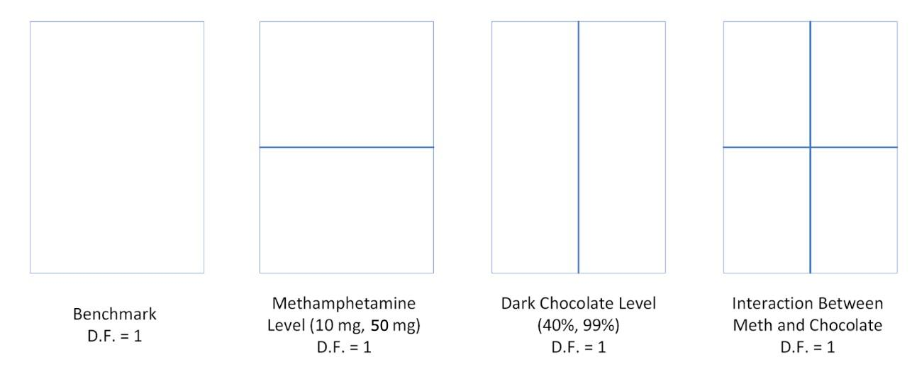
Design
2^{k} Factorial with k = 2
Factor 1: Methamphetamine Injection - 10mg, 50mg
Factor 2: Dark Chocolate - 40%, 99%
Interaction between methamphetamine and dark chocolate considered
Response: Time to complete pairs memory game with 30 cards

Slide 5
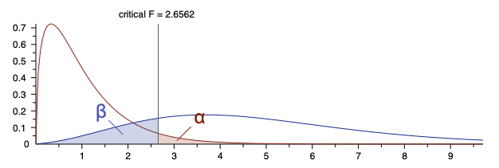
Sampling Methods
How we sampled:
Males aged 22-31
Randomly selected from Hofn, Ironbard
Sample size determination:
Power of 80%
Alpha of 0.05
Effect Size of 0.25
GPower returned sample size of 179
4 treatment groups, 45 in each group
Total sample size of 180
Notes:
Kliegel, M., & Jager, T. (2006). Delayed–Execute Prospective Memory Performance: The Effects of Age and Working Memory. Developmental Neuropsychology, 30(3), 819–843. https://doi.org/10.1207/s15326942dn3003_4
Link to website: https://www.tandfonline.com/doi/abs/10.1207/s15326942dn3003_4
This is a citation of a scientific article mentioning that those in the age group 22-31 have similar memory test scores.

Slide 6
Methods
Random assignment with R: 45 islanders per group
Groups:
40% Dark Chocolate and 10 mg Methamphetamine
40% Dark Chocolate and 50 mg Methamphetamine
99% Dark Chocolate and 10 mg Methamphetamine
99% Dark Chocolate and 50 mg Methamphetamine
Gave chocolate then waited 15 minutes and injected methamphetamine
Directly after injection, recorded time to complete memory game
Imported data into R for analysis
Notes:
Article supporting that it takes 15 minutes for chocolate to have an effect:
https://www.telegraph.co.uk/food-and-drink/features/the-science-of-what-chocolate-does-to-your-body/#:~:text=Chocolate%20gives%20us%20immediate%20sensory,chocolate%2C%20the%20most%20sugary%20kind.
Article supporting that methamphetamine injection has instant effect:
https://nida.nih.gov/publications/research-reports/methamphetamine/how-methamphetamine-misused

Slide 7
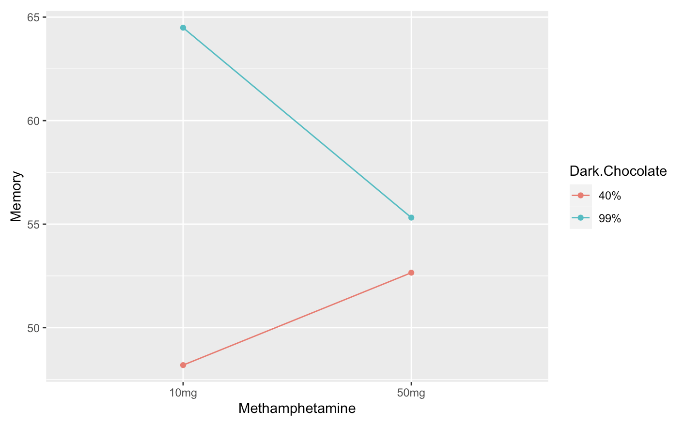
Interaction Plot

Slide 8
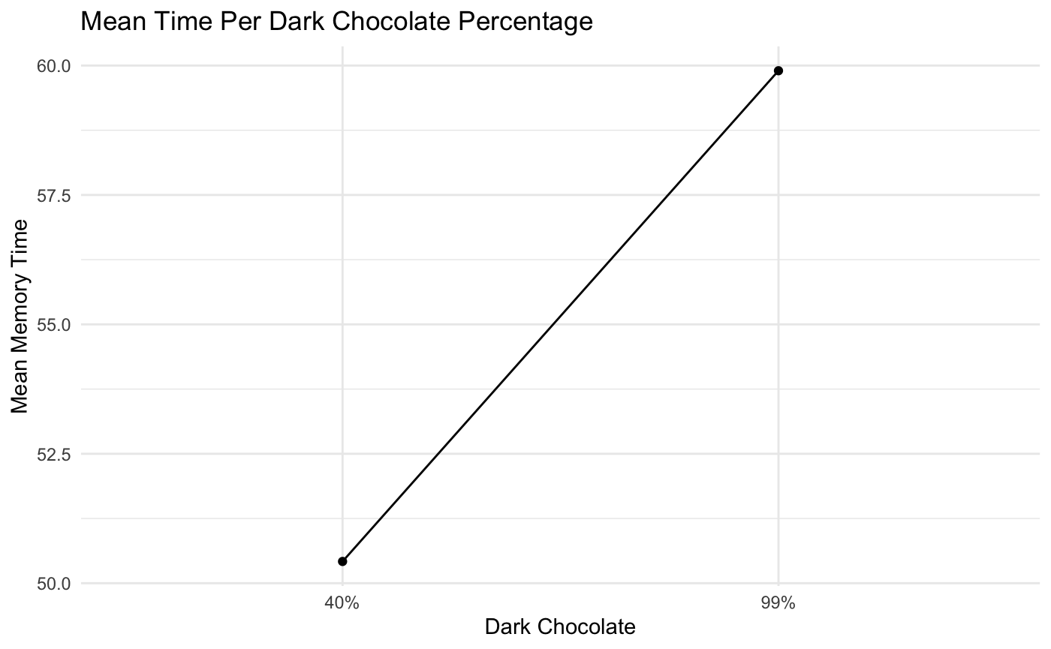
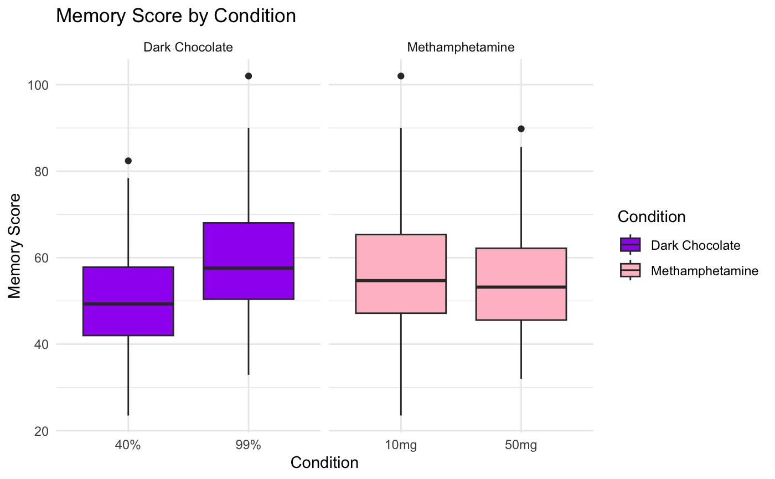
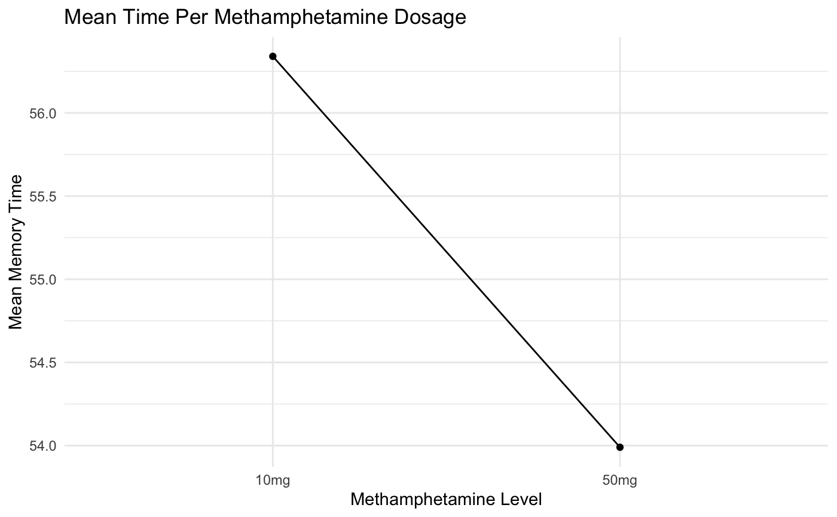
Comparison

Slide 9
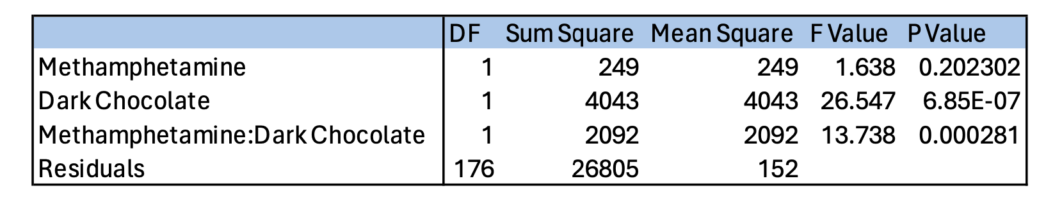
ANOVA Results
Dark chocolate and the interaction between dark chocolate and methamphetamine was significant.
Methamphetamine on its own was not significant.

Slide 10
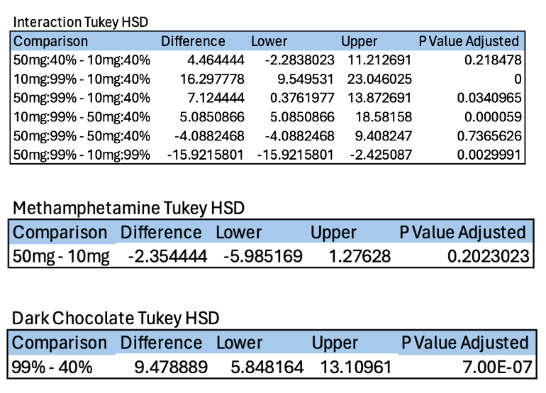
Post-hoc TukeyHSD

Slide 11
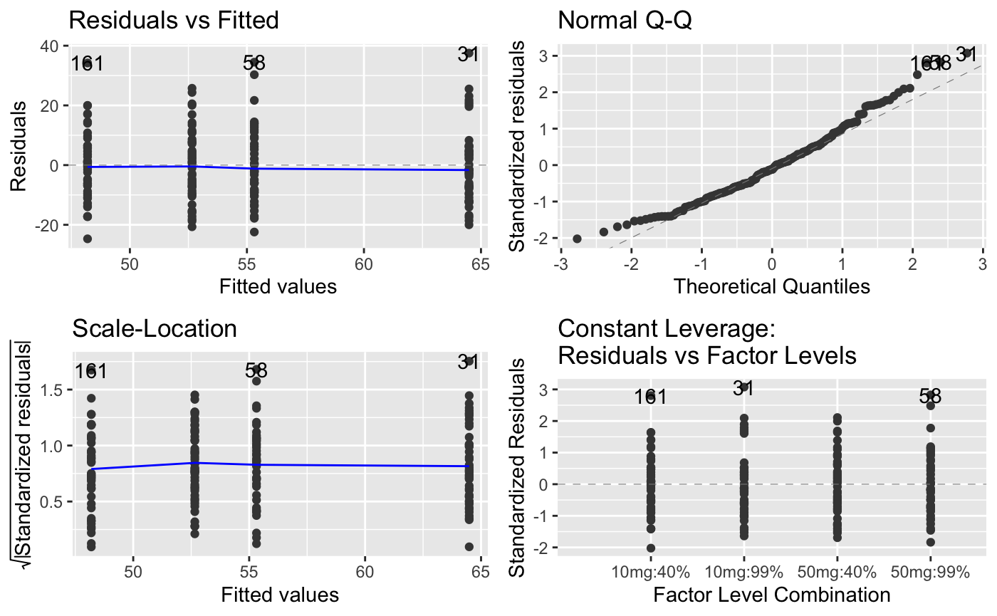
Checking The Model Assumptions
Notes:
On the residuals vs fitted plot, we can see a linear relationship, the blue line is straight, and the average of the errors lay around 0.
The normal Q-Q plot suggests that the errors are approximately normal.
The scale-location plot suggests that there is approximately a constant variance of the error term.
The residuals vs factor levels plot suggests that there may some possible outliers/leverage points.
But, overall, our assumptions for the model seem to be met.

Slide 12
Conclusions
Our study concludes that, while methamphetamine dosage alone did not significantly impact memory performance, the percentage of cocoa in dark chocolate demonstrated a significant effect. Our study has shown that, 15 minutes after consumption, 99% cocoa content in dark chocolate is associated with better memory performance than 40% cocoa content. Furthermore, we have also found a significant interaction between cocoa content and methamphetamine, as revealed by the results of our Tukey test. We have found that, while methamphetamine alone may not significantly alter memory, the inclusion of high cocoa dark chocolate can significantly enhance memory performance.

Slide 13
Future Research Questions
What are the long term effects of repeated consumption of dark chocolate and methamphetamine on memory?
Could dark chocolate and methamphetamine have an effect on other cognitive functions?
Could a broader range of cocoa percentages and levels of methamphetamine injections have a different effect on memory?
Could different doses of methamphetamine, beyond 10mg and 50mg, impact memory performance significantly without combining them with dark chocolate?
Are there gender differences in the memory effect of dark chocolate and methamphetamine?

